Slide 1






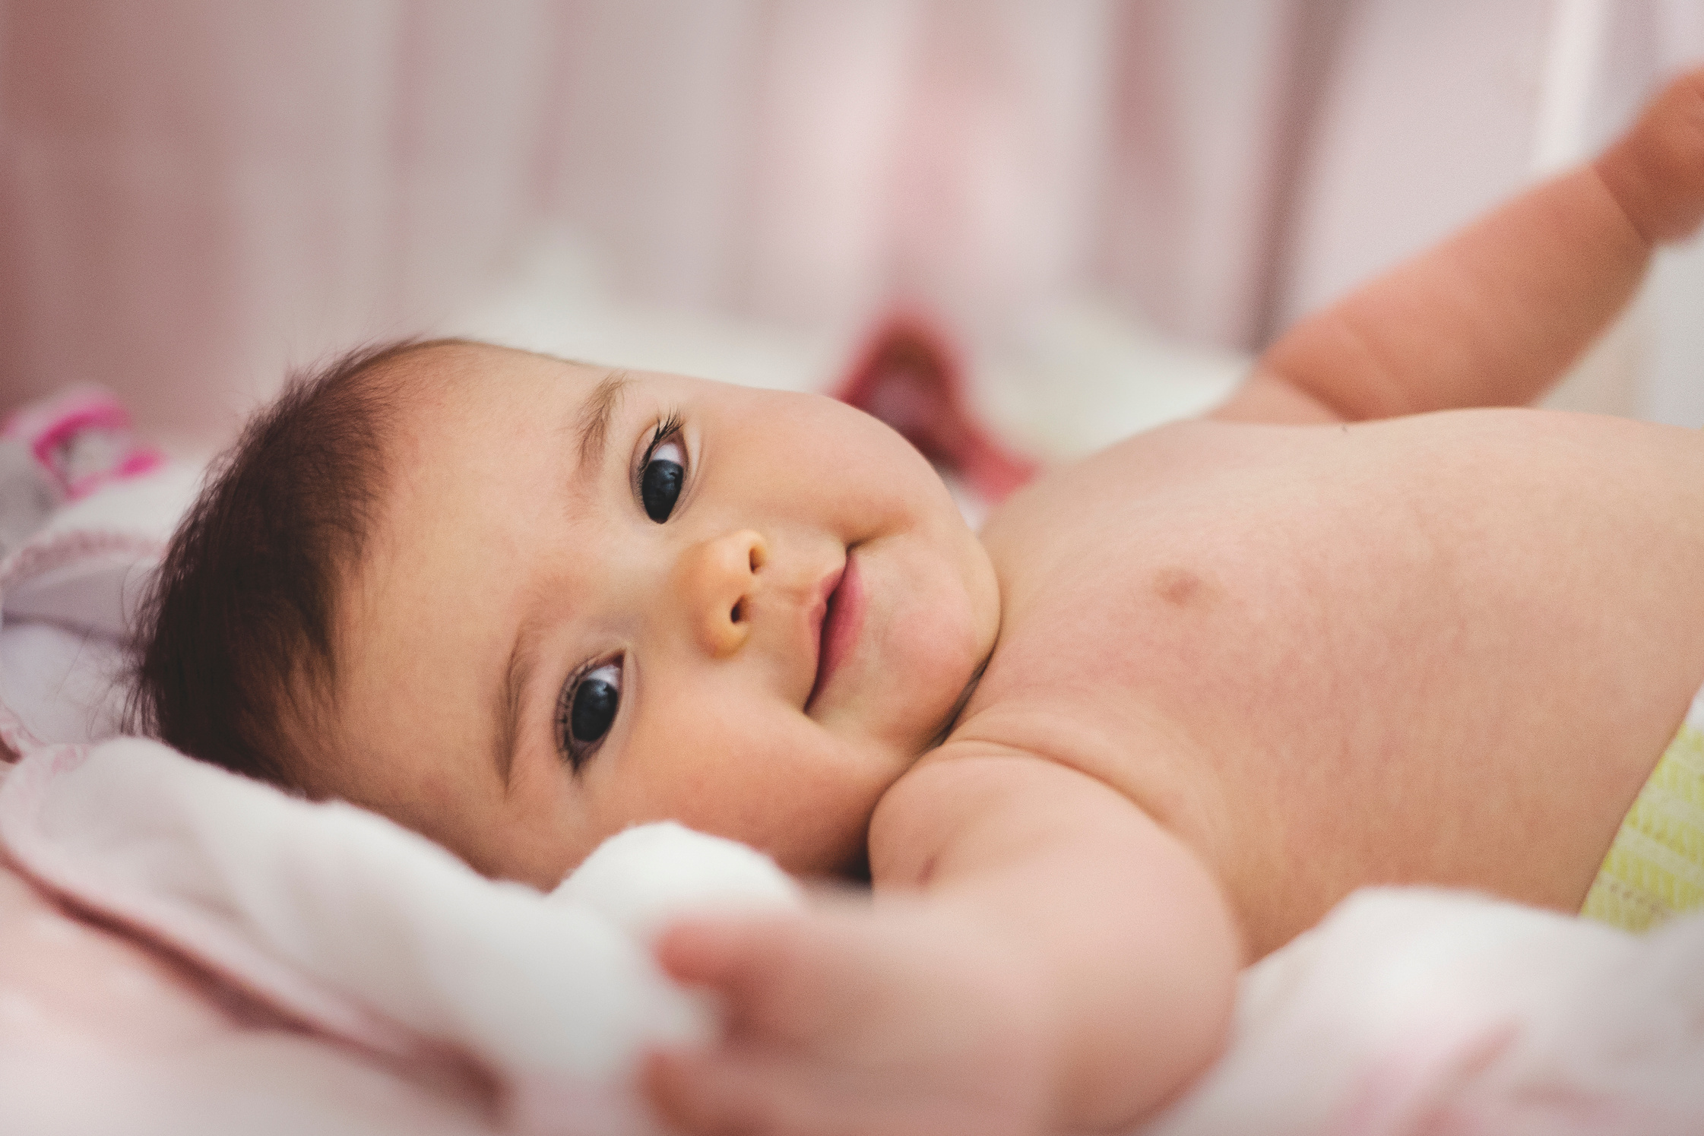
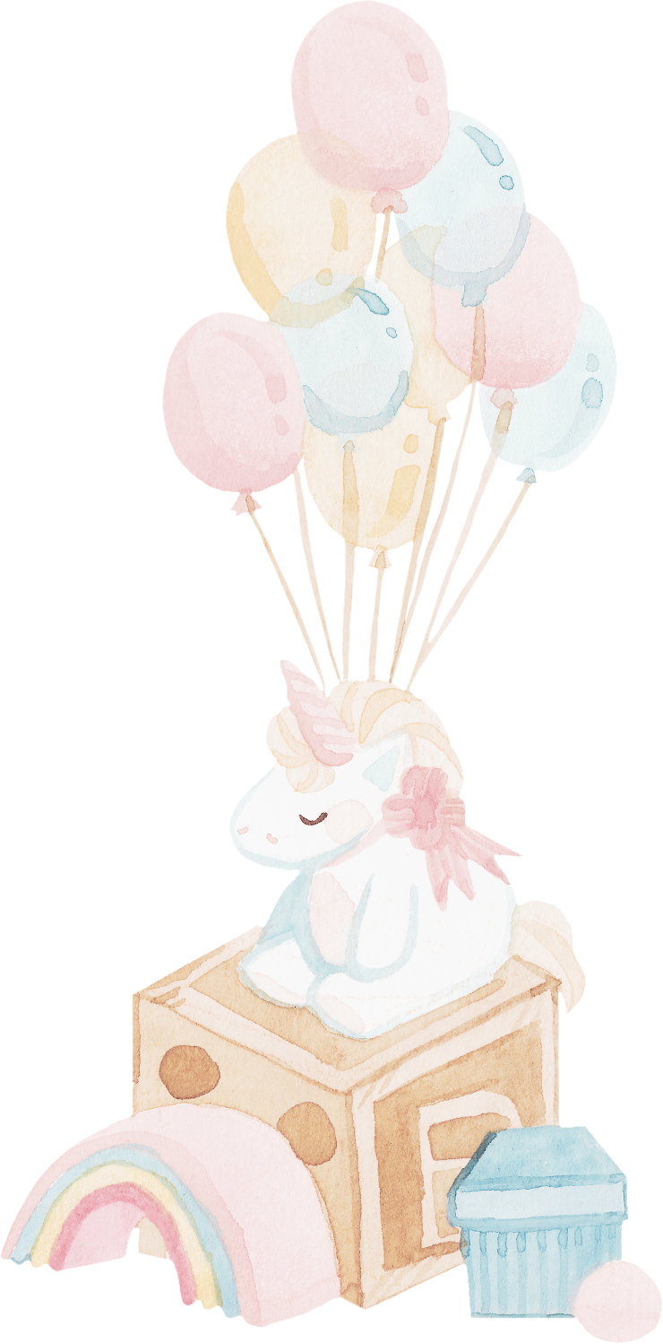

WELCOME TO
Olivia's
BIRTHDAY
PARTY
ON JUNE 19TH AT 2PM

